Slide 1

DURGA MAHAVIDYALAYA RAIPUR (CG)
8 CG GIRLS BN, NCC; NCC ACTIVITIES YEAR-2022-2023
CAPT (DR) ARCHANA GOMASTA ASSISTANT PROFESSOR & ASSOCIATE NCC OFFICER

Slide 2

YEAR WISE ENROLLED STRENGTH COMPANY NO-2, PLATOON-A
ORTHRISED STRENGTH | ENROLLED STRENGTH | 1ST YEAR | 2ND YEAR | 3RD YEAR
56 | 56 | 28 | 12 | 16

Slide 3
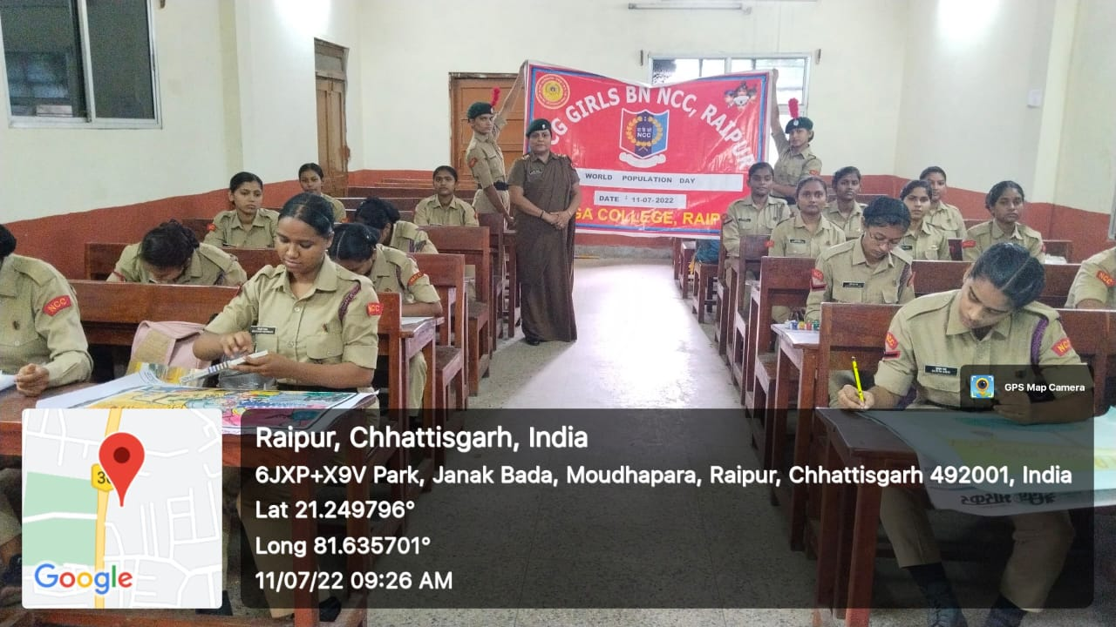
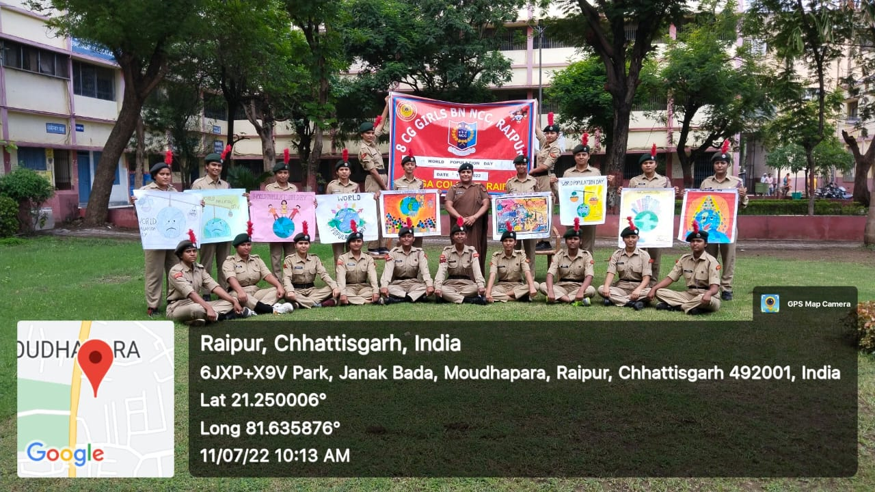
SPEECH & DRAWING COMPETITION WAS CONDUCTED UNDER AGES OF WORLD POPULATION DAY ON 11TH JULY 2022

Slide 4
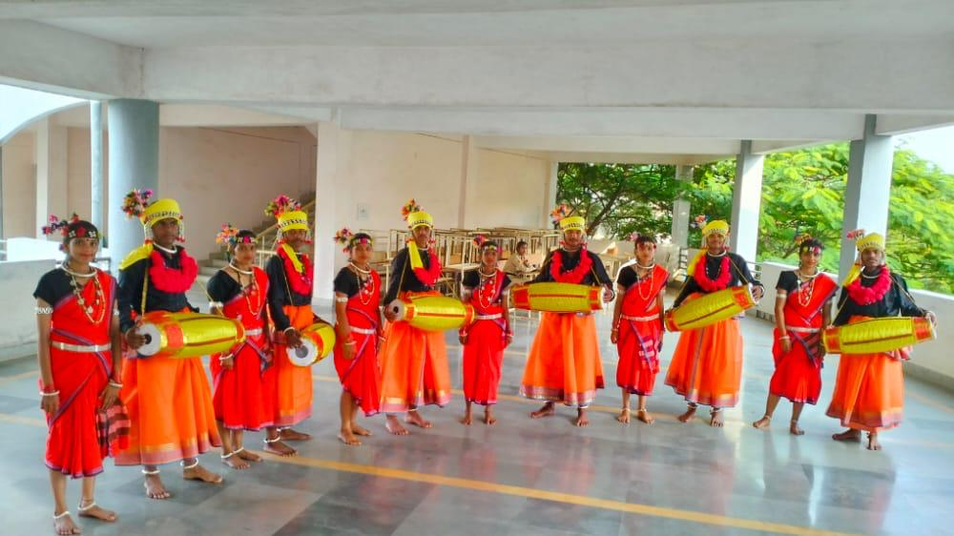
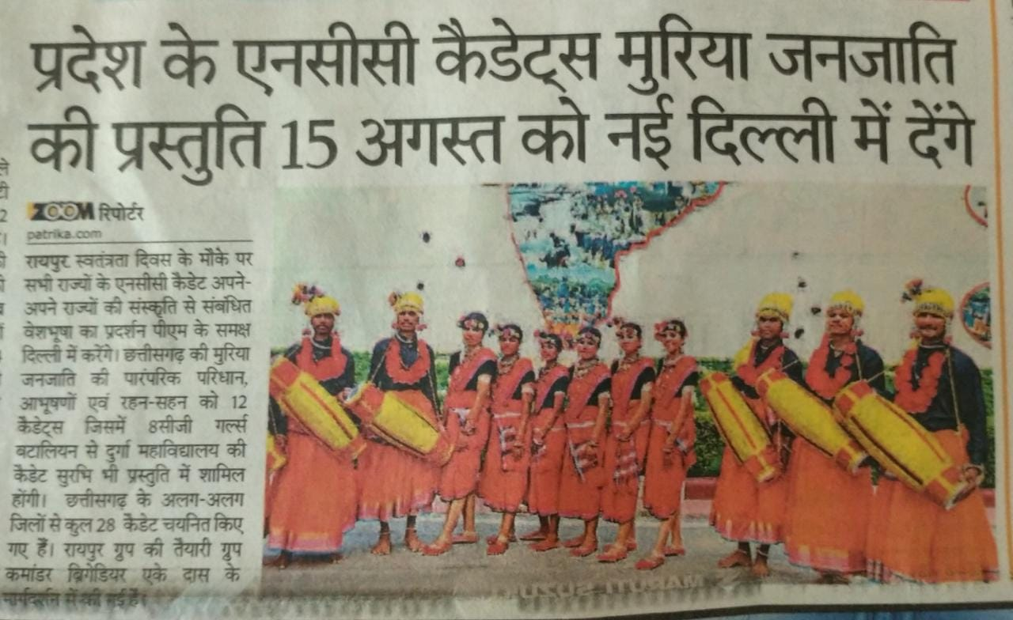
IDC – EBSB INDEPENDENCE DAY CAMP UNDER AGES OF EK BHARAT SHRESHTHA BHARAT CAMP WAS HELD AT DELHI FROM 1ST AUGUST 2022 TO 15TH AUGUST 2022
Cadet Surabhi Dewanagan of our college got opportunity to attend the above camp.

Slide 5
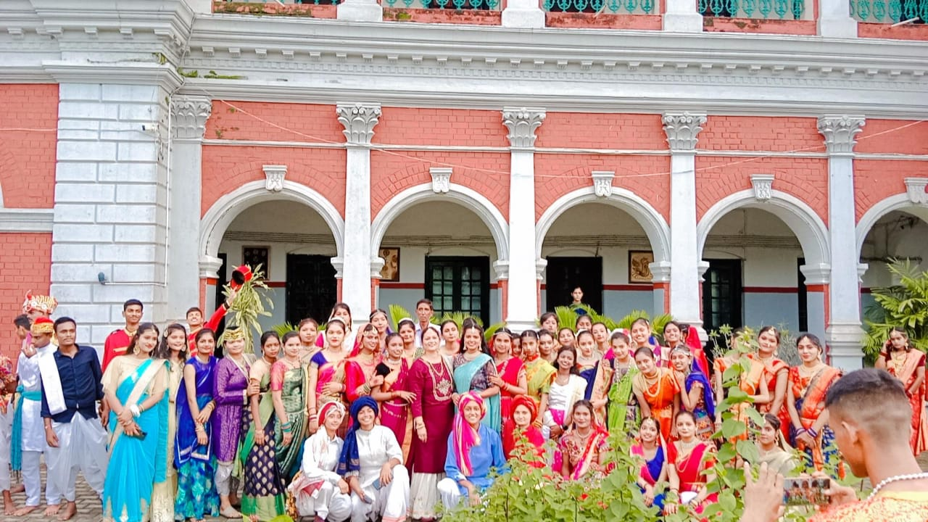
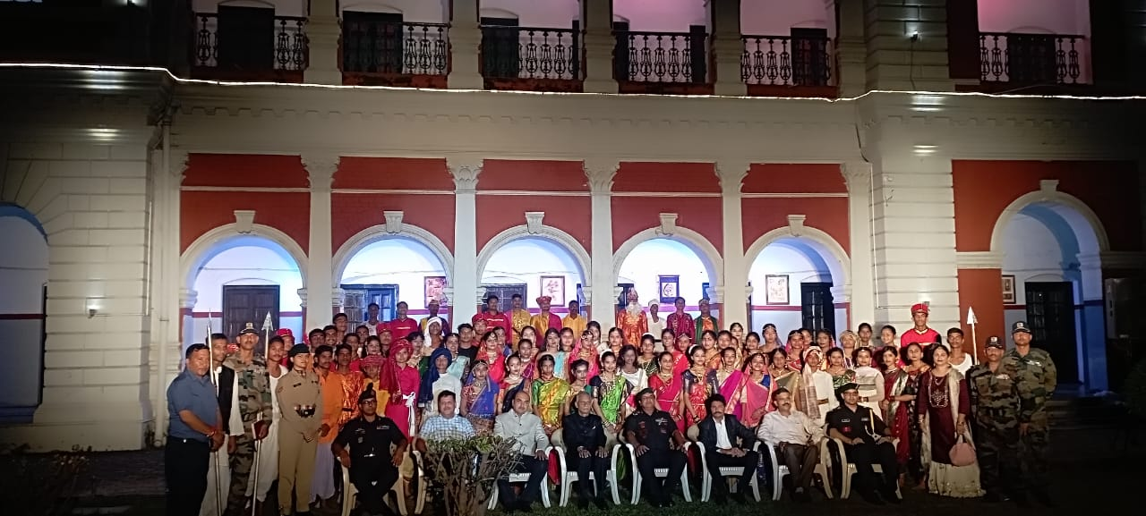
LIGHT AND SOUND PROGRAM HELD AT RAJKUMAR COLLEGE PREMISES ON 12TH AND 13TH AUGUST 2022( 7 CADETS PARTICIPATED)

Slide 6
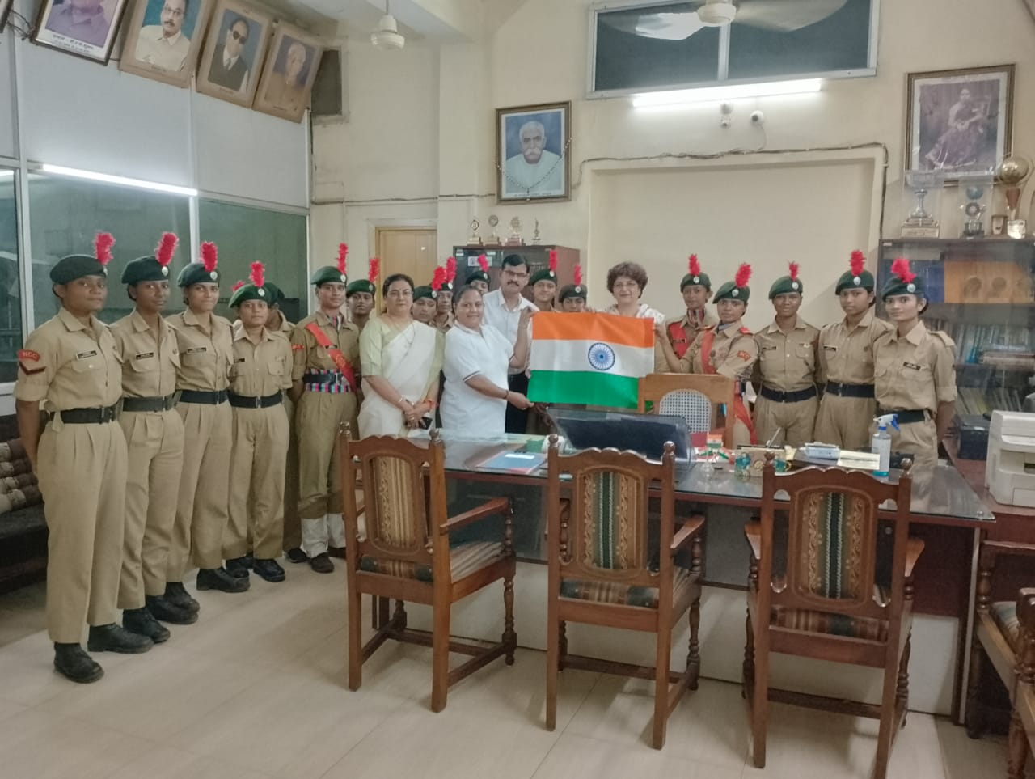
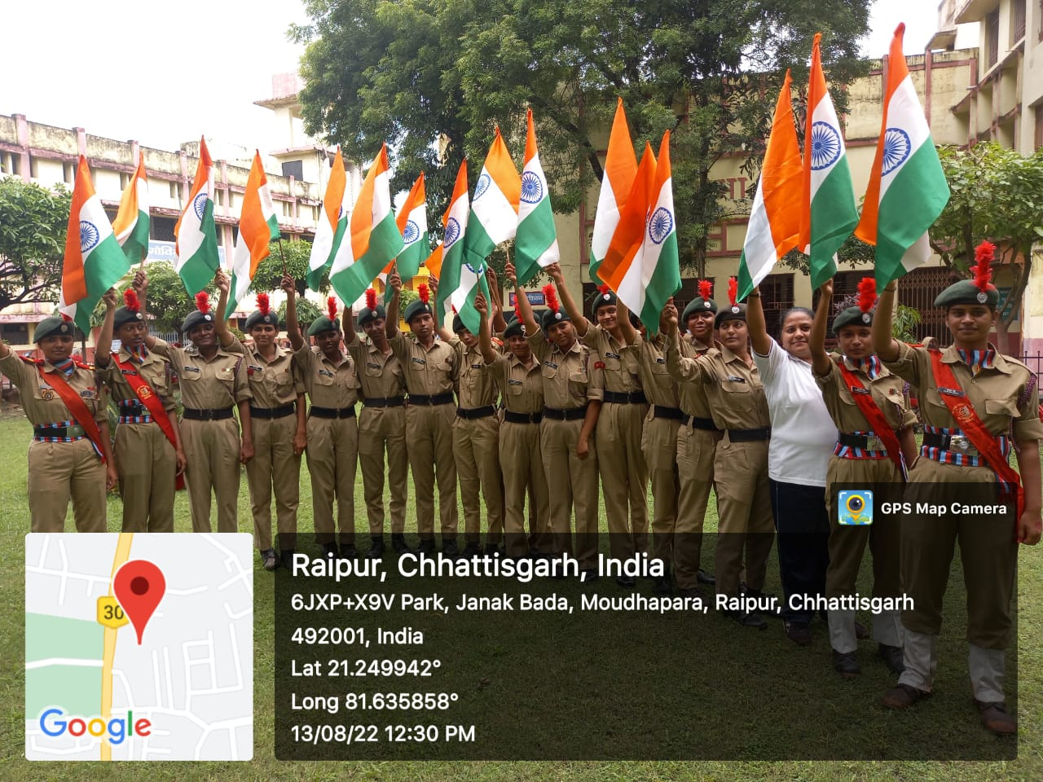
ON THE OCCASSION OF 75TH INDEPENDENCE DAY UNDER AGES OF “HAR GHAR TIRANGA”, NATIONAL FLAG WAS DISTRIBUTED ON 13TH AUG 2022 AMONG STUDENT, STAFF AND NEAR BY COLLEGE AREA AND ASKED THEM TO UNFOLD THE FLAG AT THEIR HOME ON 15TH AUGUST WITH FULL OF ENTHUSIASM AND PATRIOTISM

Slide 7






ON GIVEN ONLINE SITE 32 CADETS UPLOADED SELFIE UNDER AGES OF THE MINISTRY OF CULTURAL TO MARK AZADI KA AMRIT MAHOTSAV ON THE OCCASION OF “HAR GHAR TIRANGA”

Slide 8
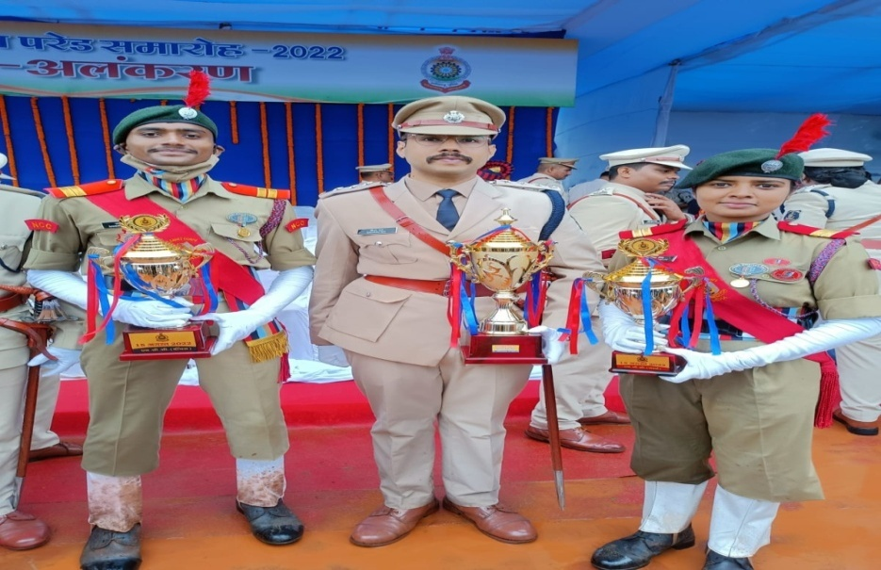
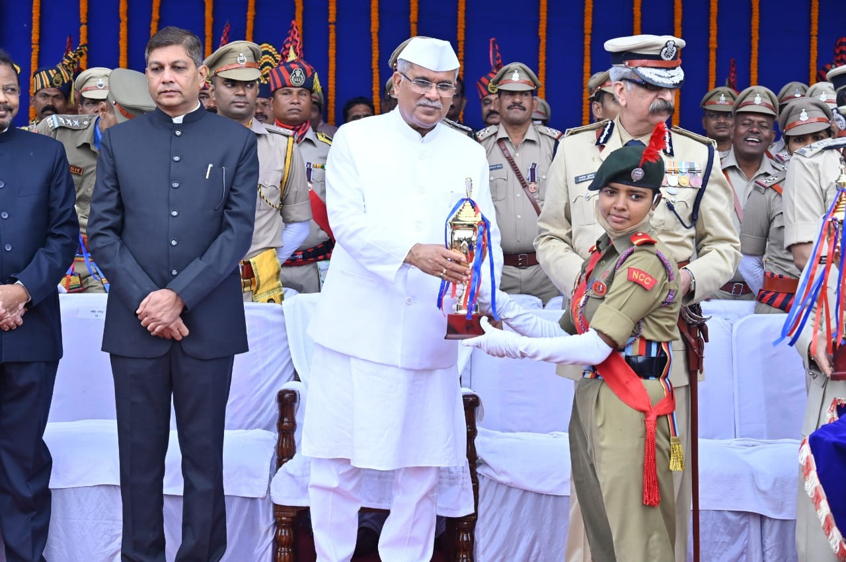
75TH INDEPENDENCE DAY CELEBRATED AT POLICE PARADE GROUND RAIPUR, 6 CADETS FROM OUR COLLEGE TOOK PART AND SUO PRIYA SINGH WAS HONORED TO BE THE PARADE COMMANDER, BY THE SHRI BHUPESH BAGHEL CM CHHATTISGARH AND ALSO 8CG GIRLS BN NCC TEAM BAGGED 1ST POSITION

Slide 9
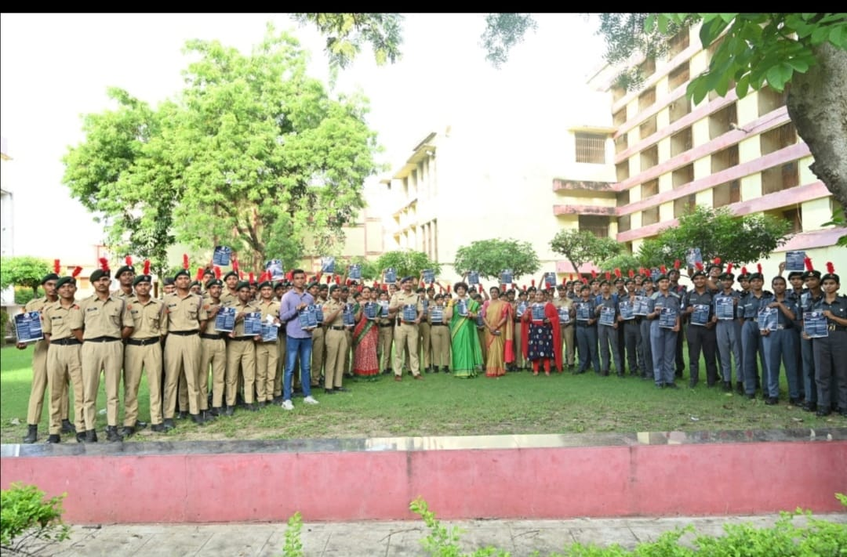
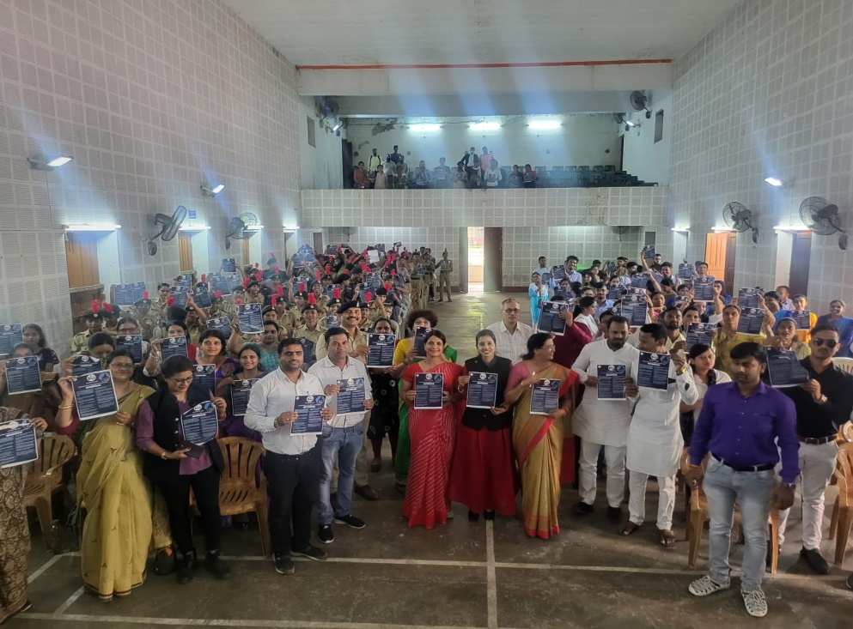
CYBER CRIME AWARENESS PROGRAM WAS ORGANIZED BY THE CIVIL AUTHORITY (CHHATTISGARH POLICE ) AT COLLEGE PREMISES ON 19TH AUGUST 2022

Slide 10




LOGO UPLOADED AT NCC DIGITAL FORUM UNDER AGES OF PUNEET SAGAR ABHIYAN ON 10TH SEPTEMBER 2022
13 CADETS WERE UPLOADED LOGO MADE BY THEMSELVES

Slide 11
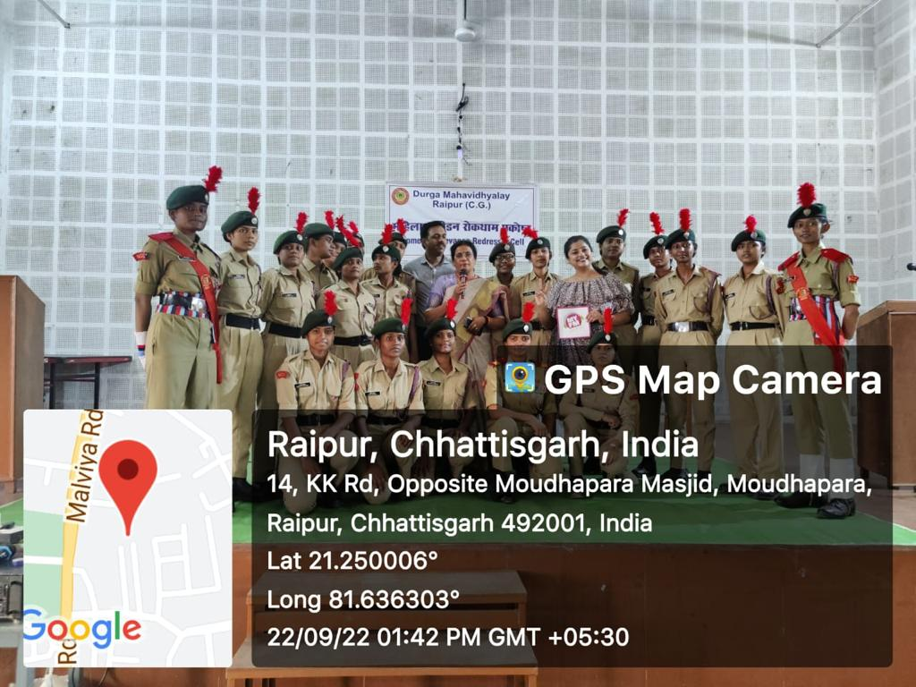
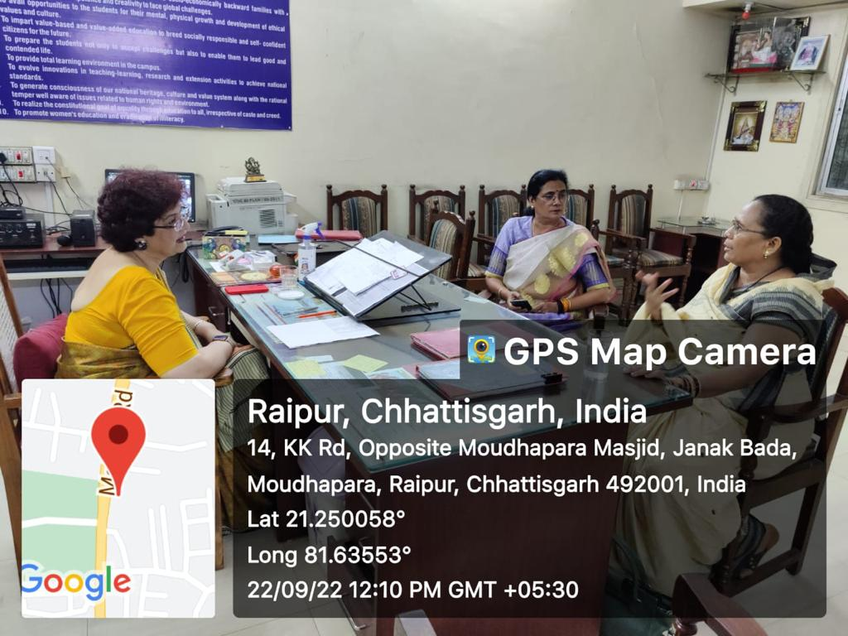
MOTIVATIONAL LECTURE BY PADMSHREE PHOOLBAI BASAN UNDER AGES OF WOMEN'S GRIEVANCE CELL OF COLLEGE AUTHORITY ON 22nd SEPTEMBER 2022

Slide 12
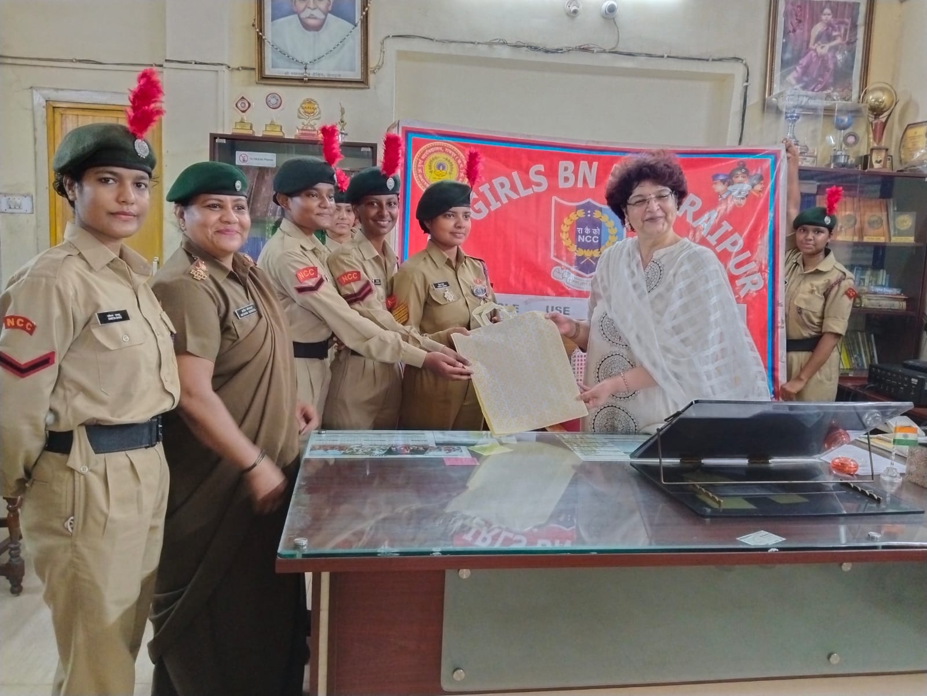
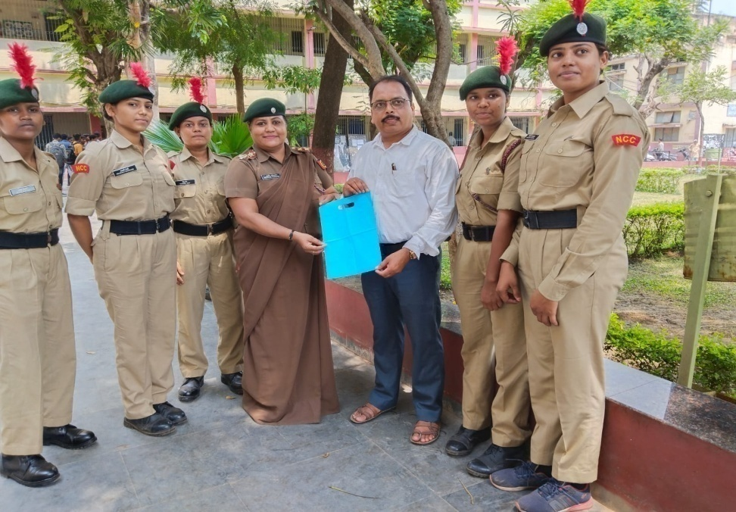
SINGLE USE PLASTIC AWARENESS PROGRAM WAS ORGANISED AT COLLEGE PREMISES AND SPREAD AWARENESS NEAR BY SHOPS AT MOUDHAPARA, RAIPUR ON 29TH SEPTEMBER 2022

Slide 13
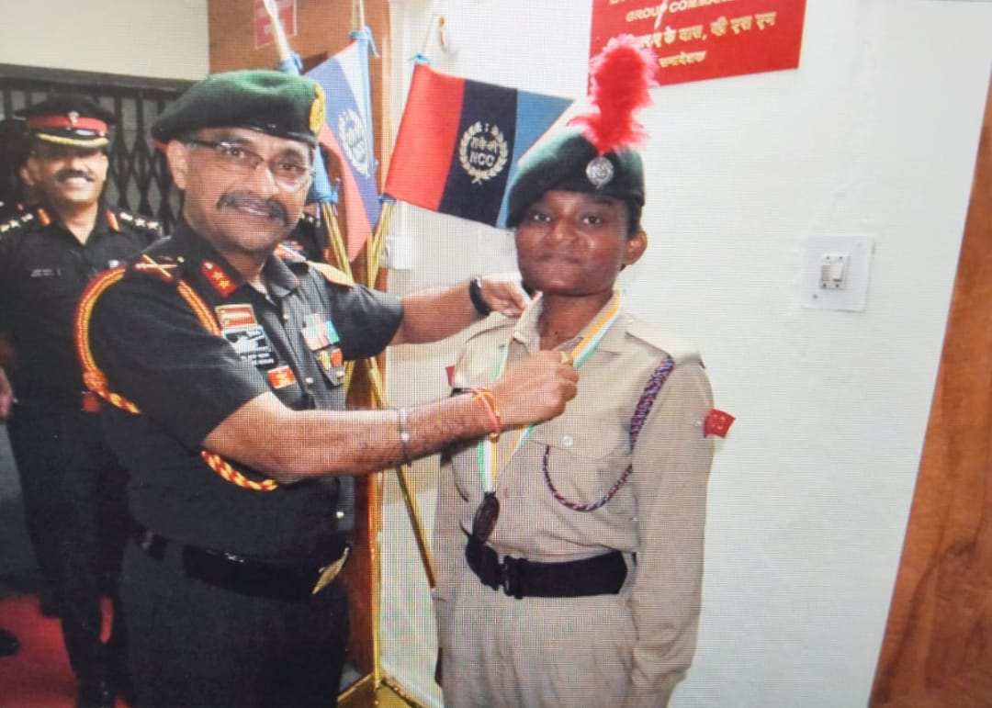
SGT LATA MAHANAND HAS APPRECIATED BY THE MAJ GENERAL AJAY KUMAR MAHAJAN, ADG MADHYA PRADESH AND CHATTISGARH DIRECTORATE, BHOPAL

Slide 14
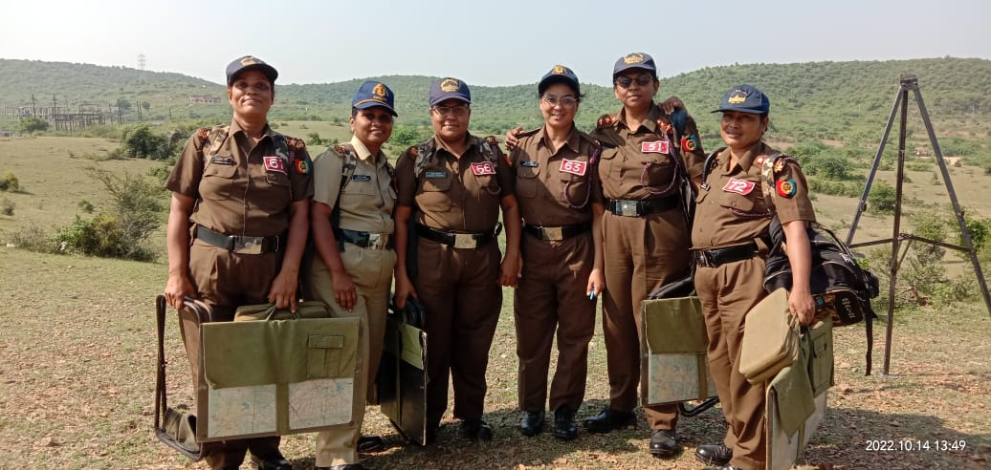
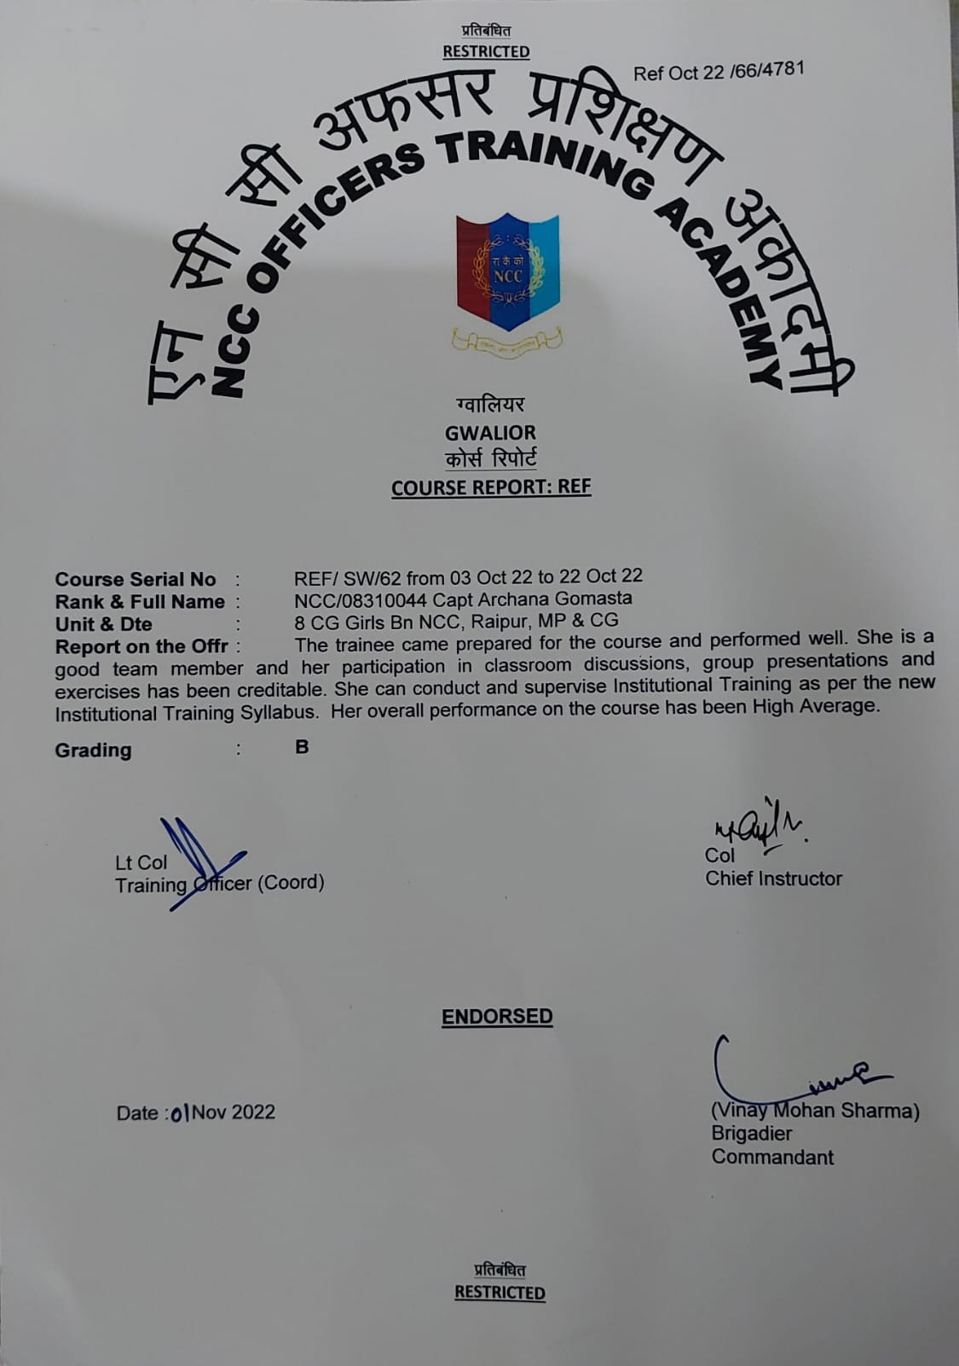
I WAS ATTENDED REFRESHER COURSE, SW-64 AT OTA GWALIOR FOR MAJOR RANK FROM 03RD OCTOBER TO 22ND OCTOBER 2022

Slide 15
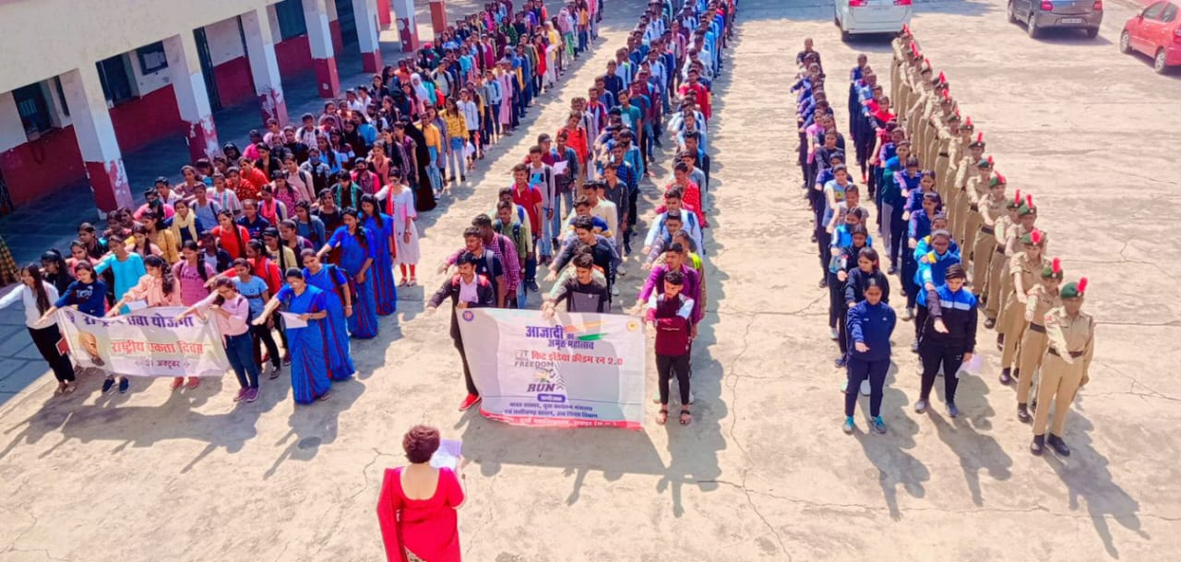
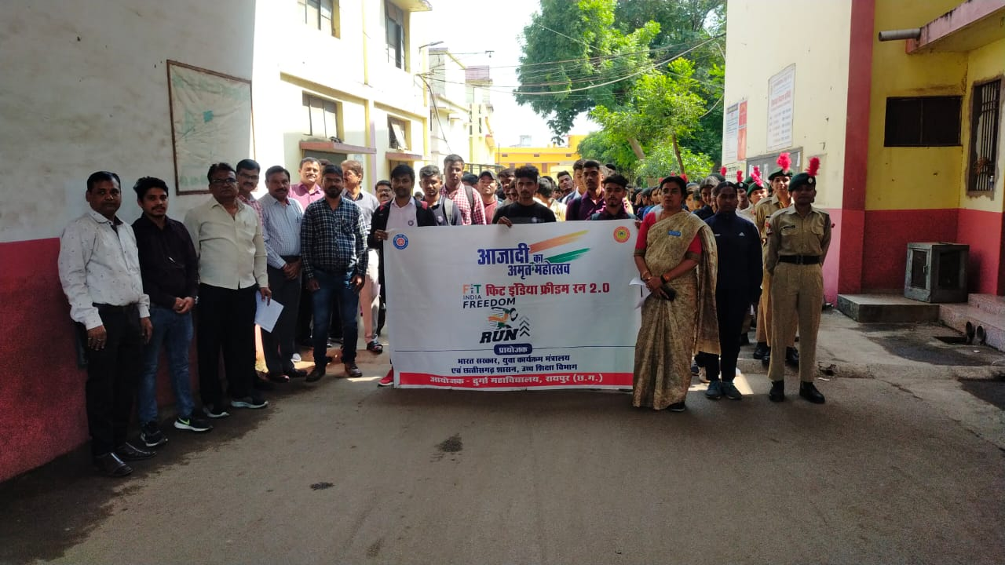
ON THE OCCASION OF “UNITY DAY” IN THE MEMORY OF SARDAR VALLABHBHAI PATEL’S BIRTH ANNIVERSARY ON 31ST OCTOBER 2022, OATH TAKEN AND RALLY WAS ORGANIZED BY THE COLLEGE AUTHORITY & CADETS PARTICIPATED ACTIVELY

Slide 16
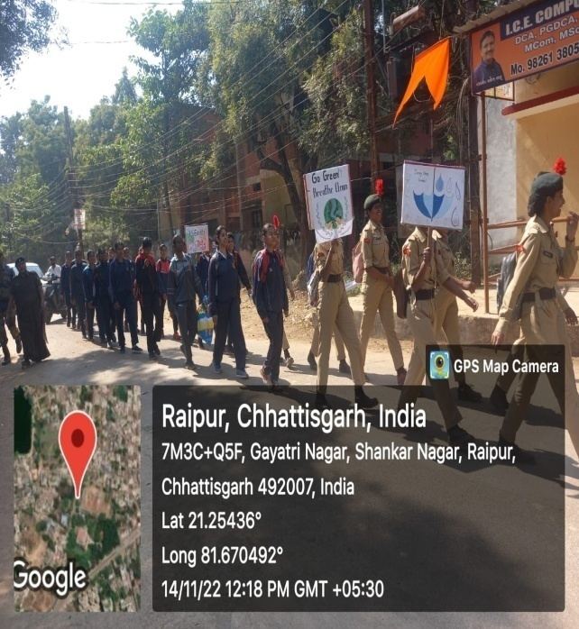
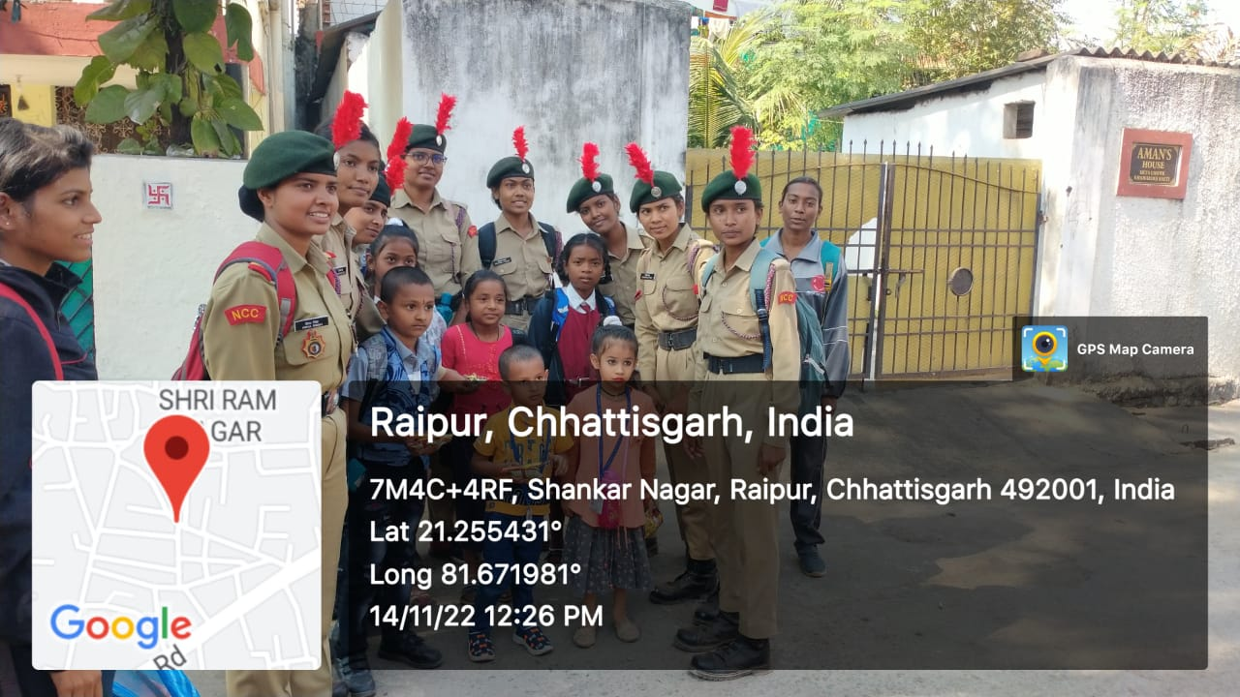
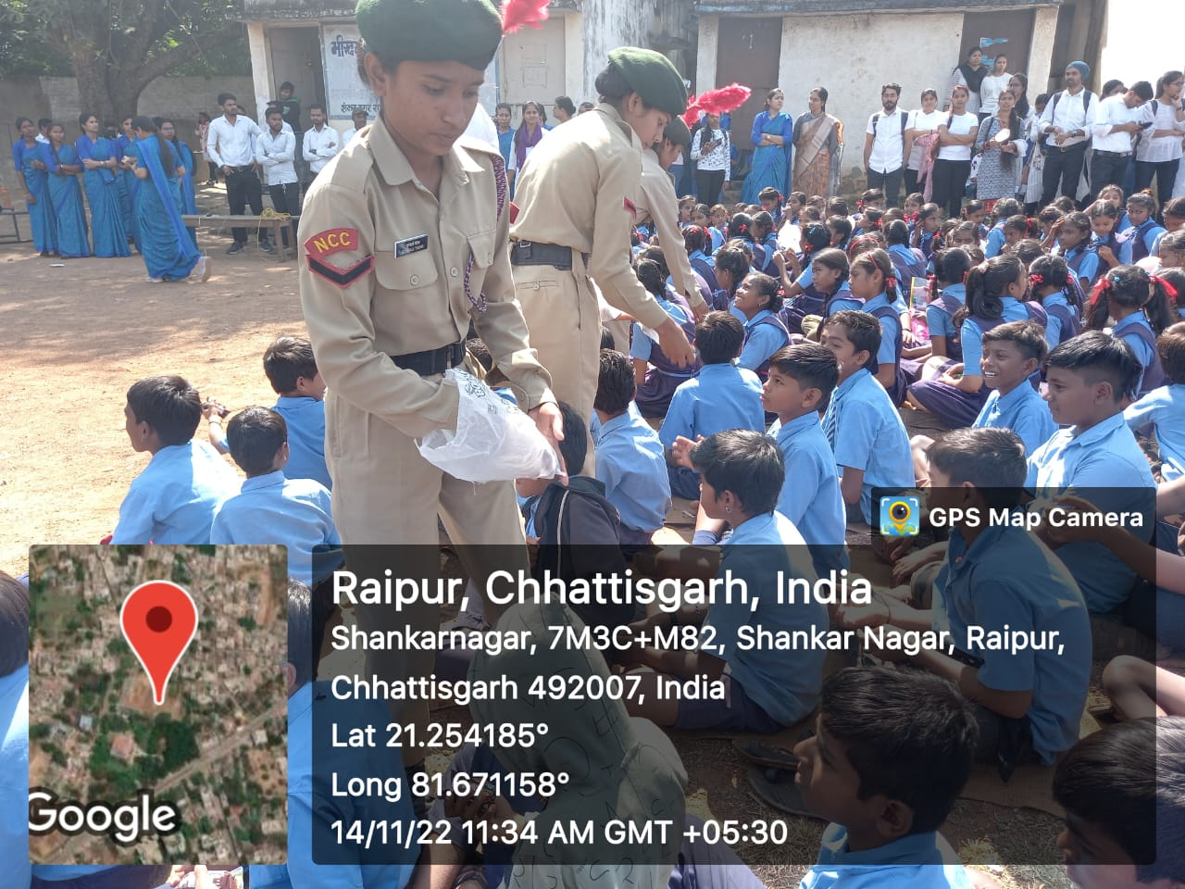
CHILDREN'S DAY CELEBRATED AT KHAMHARDIH GOVERNMENT SCHOOL AND TOOK OUT RALLY ON THE TOPIC “IMPORTANCE OF EDUCATION AND CLEANLINESS ” NEAR BY SLUM AREA ON 14TH NOVEMBER 2022.
38 CADETS WERE ACTIVELY PARTICIPATED.

Slide 17
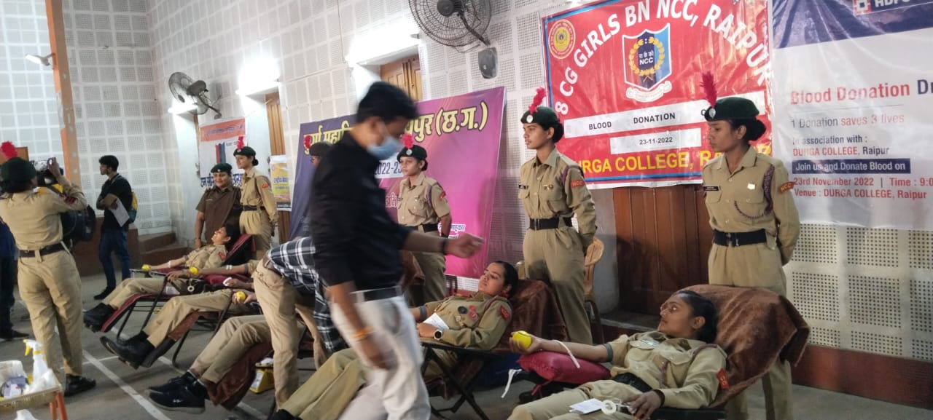
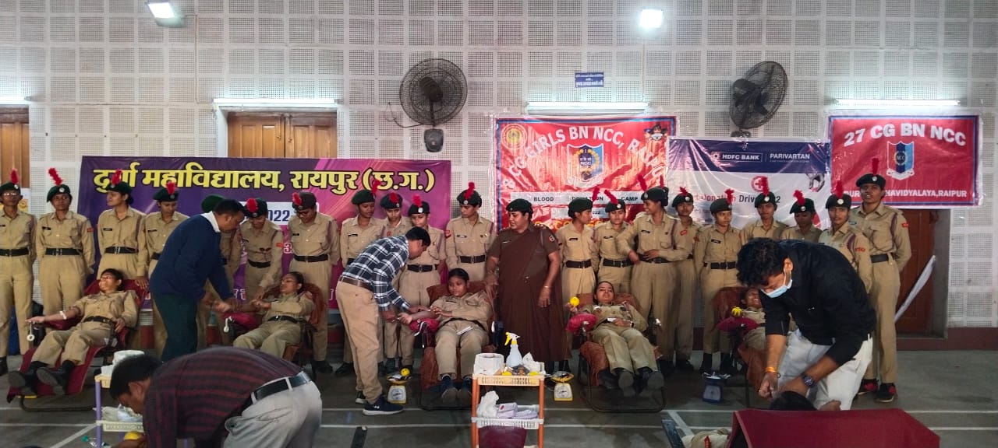
ON THE OCCASION OF 74TH NCC DAY BLOOD DONATION CAMP WAS CONDUCTED AT COLLEGE PREMISES WITH THE COLLABORATION OF HDFC BANK & RED CROSS SOCIETY ON 23RD NOVEMBER 2022
56 CADETS ACTIVELY PARTICIPATED AND 10 HAD DONATED BLOOD FOR NOBLE COST

Slide 18
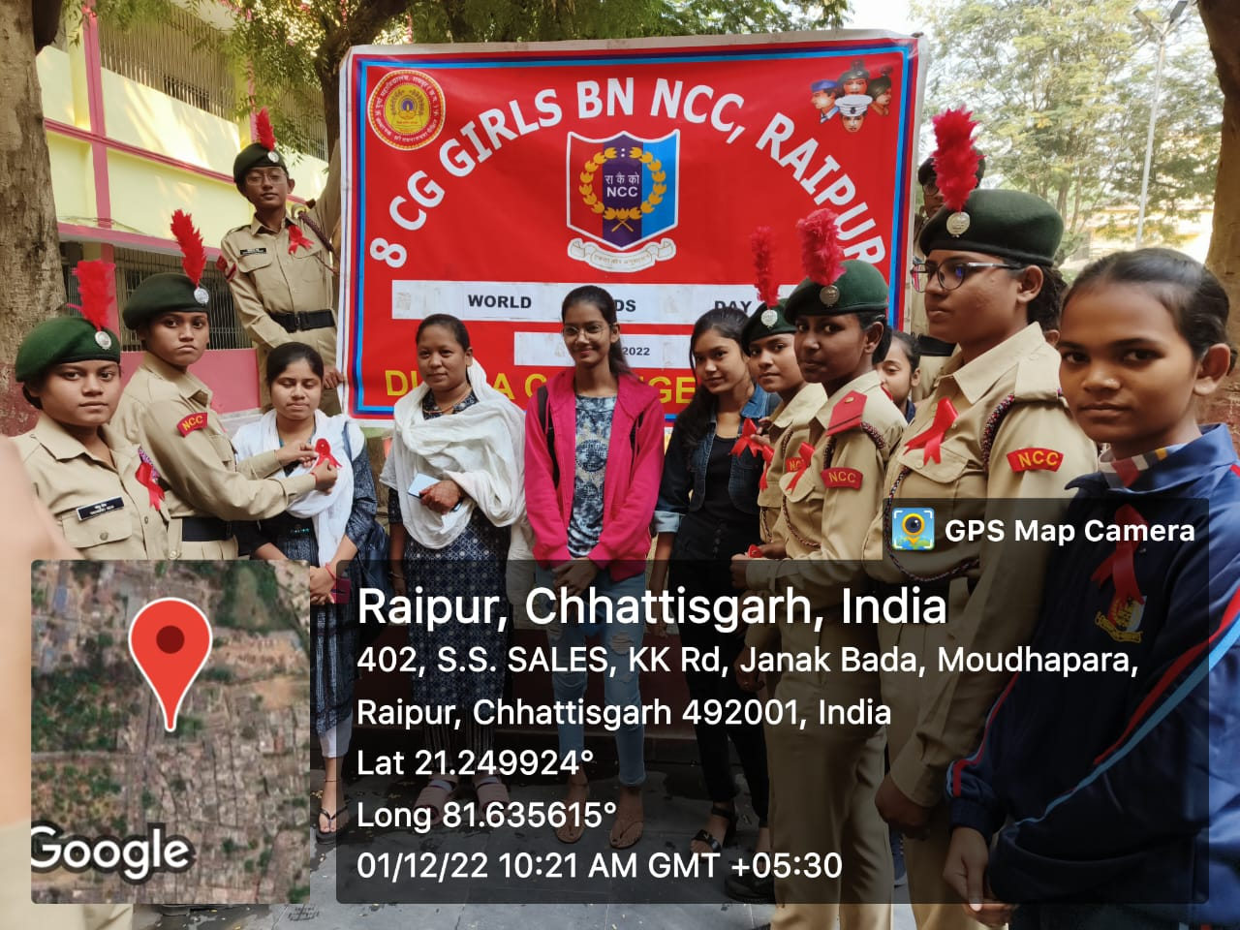
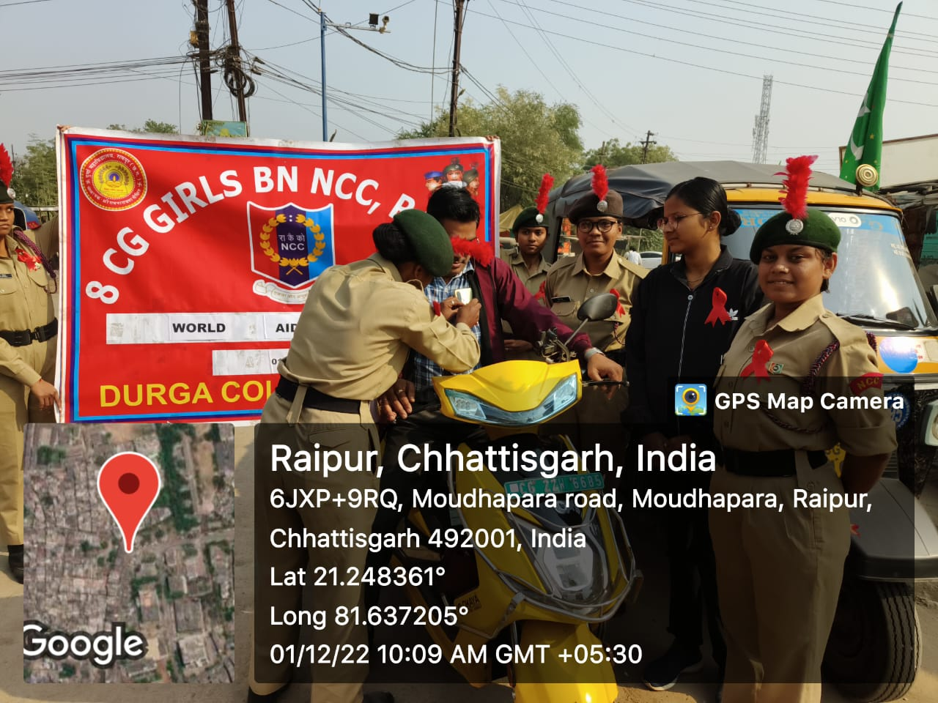
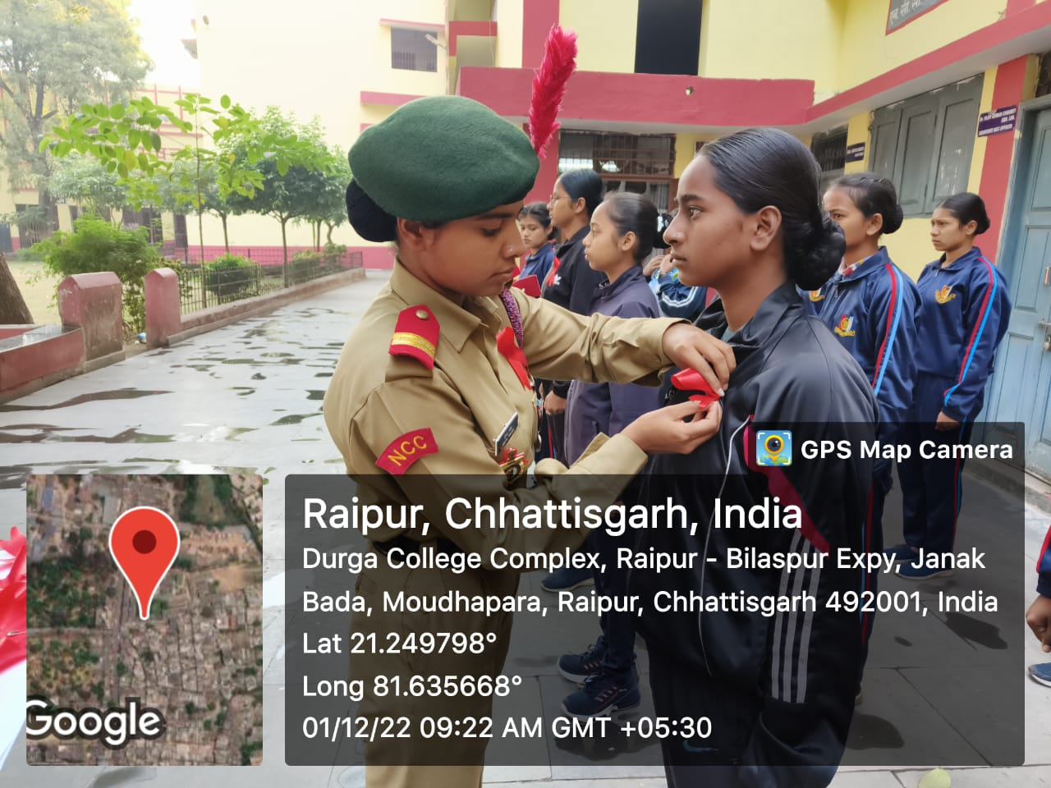
ON THE OCCASION OF WORLD AIDS DAY AWARENESS RALLY WAS CONDUCTED AND DISTRIBUTED RED RIBBON NEAR BY SLUM AREA OF MOUDHAPARA ON 01ST DECEMBER 2022

Slide 19
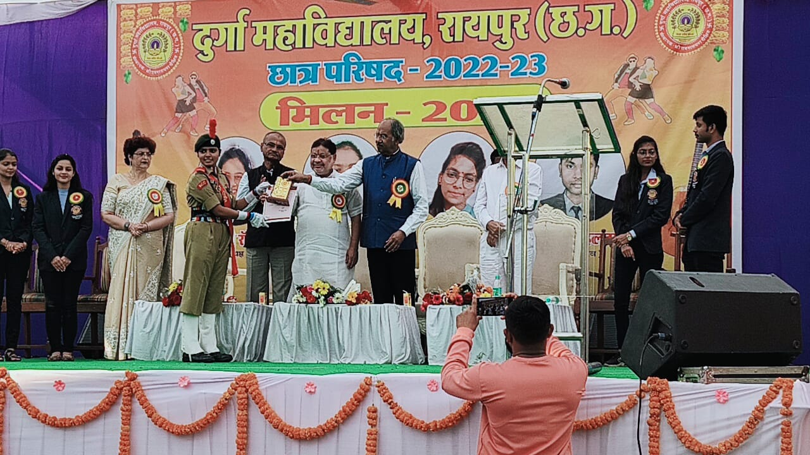
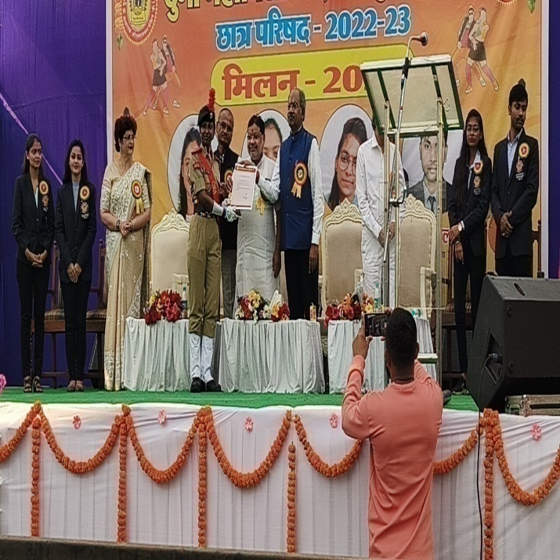
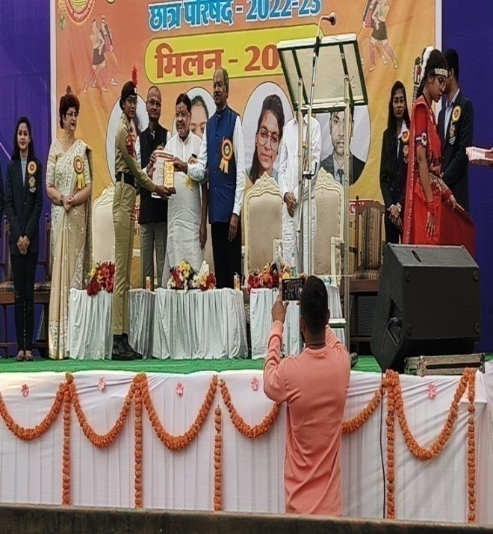
3 CADETS WERE FELICITATED BY THE COLLEGE AUTHORITY FOR THEIR EXCELLENT WORK IN THE FIELD OF NCC ON 20TH JANUARY 2023
JUO NIKITA SADHAN CHAKRABORTY
SGT KAUSHALYA SAHU
SUO PRIYA SINGH

Slide 20
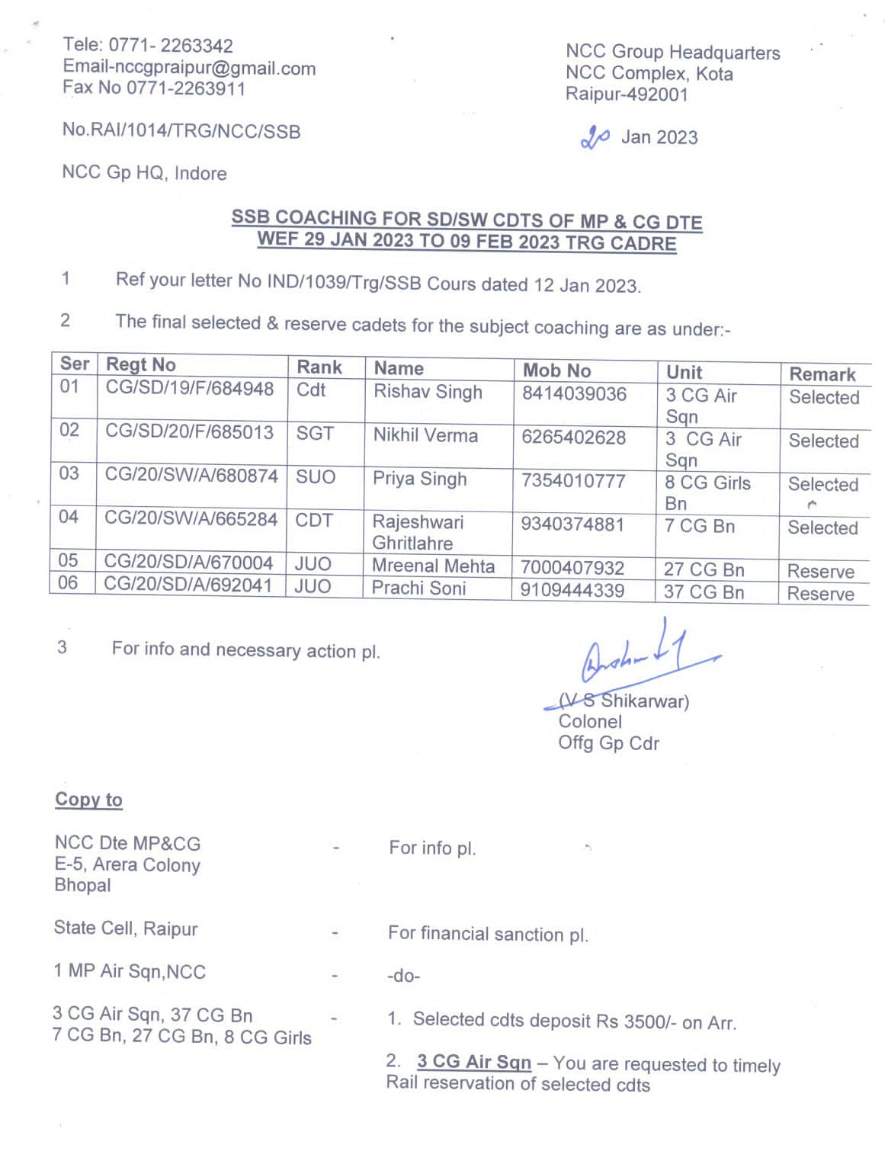
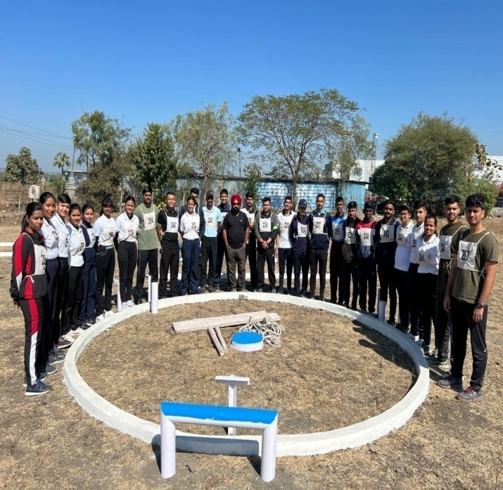
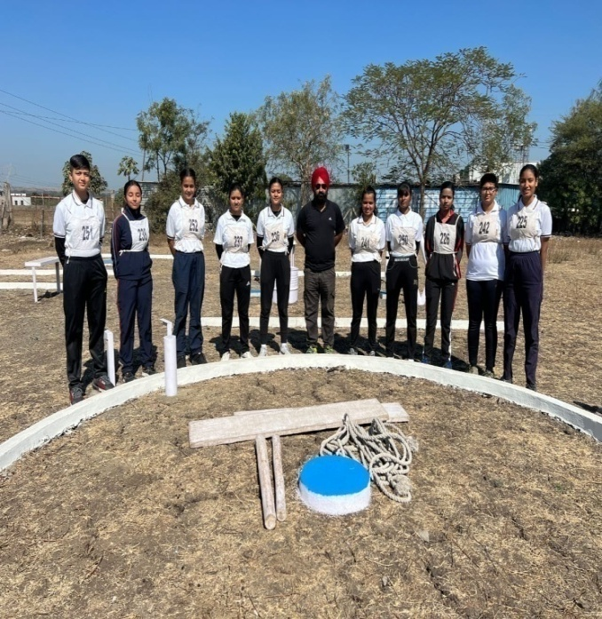
SUO PRIYA SINGH WAS SELECTED FOR SSB COACHING HELD AT INDORE FROM 29TH JAN 2023 TO 09TH FEB 2023

Slide 21
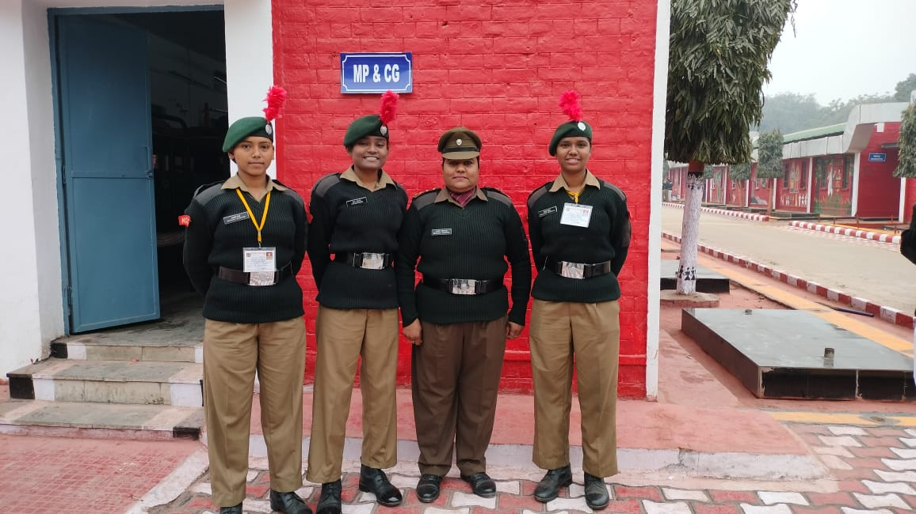
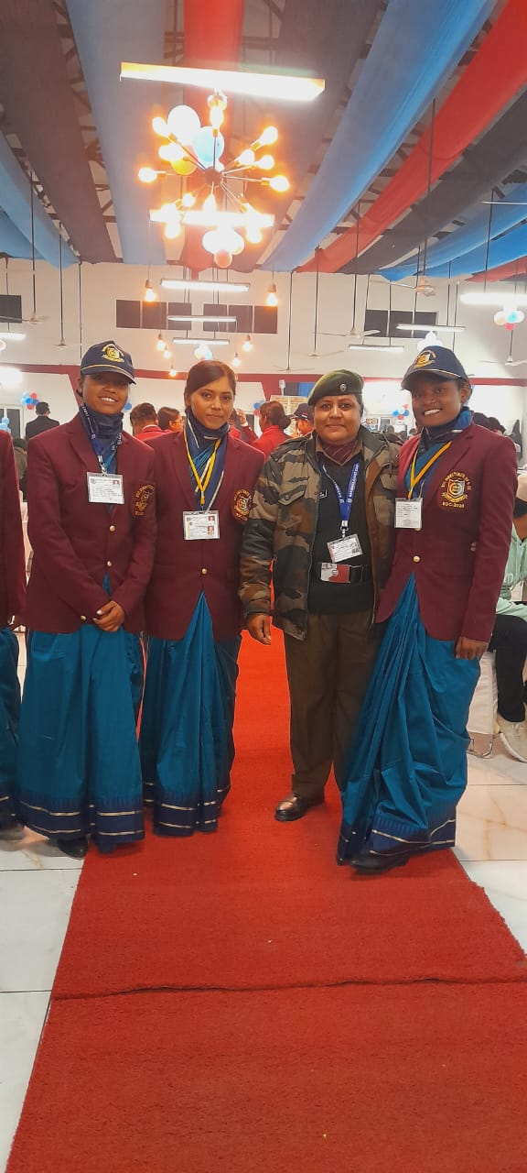
I CAPT(DR) ARCHANA GOMASTA ALONG WITH 3 CADETS OF MINE SGT LATA MAHANAND, LCPL MAUSAMI MESHRAM AND CDT PRANALI RANGARI WERE ATTENDED RDC-2023 AT DELHI FROM 01ST JAN 2023 TO 29TH JAN 2023

Slide 22
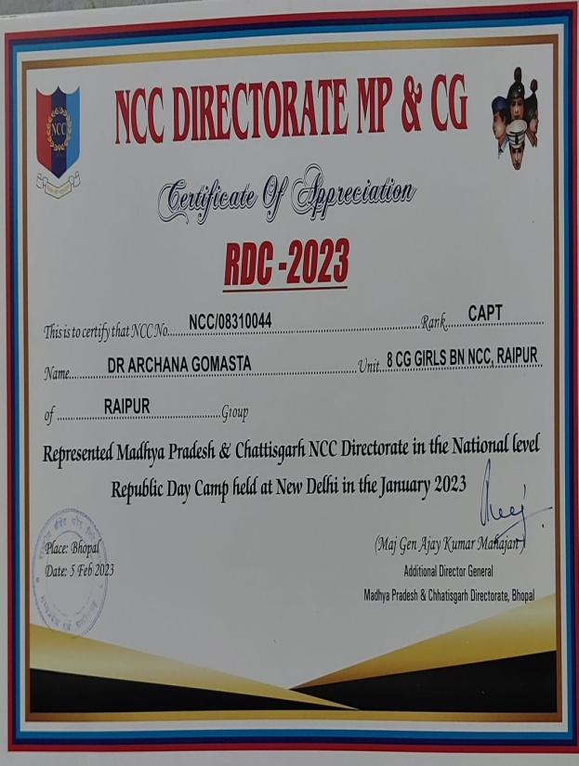
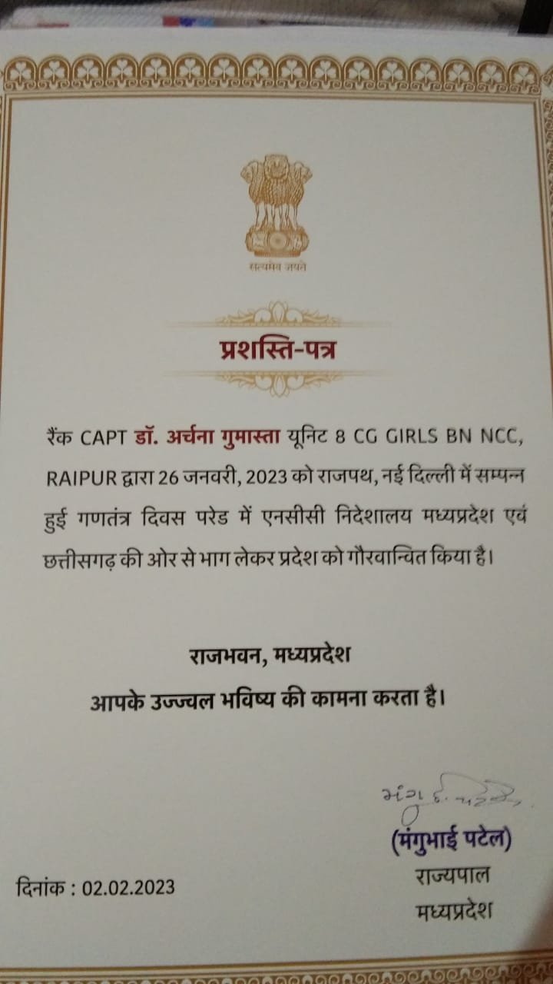
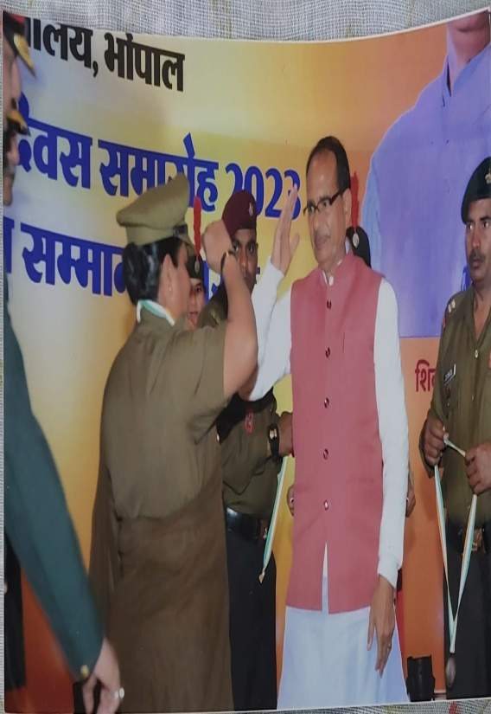
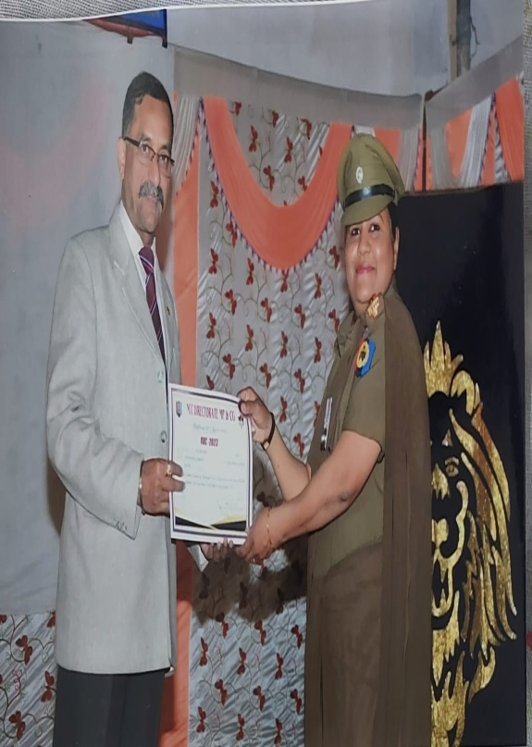
APPRECIATION BY THE CM SHRI SHIVRAJ SINGH CHAUHAN, GOVERNOR SHRI MANGU BHAI PATEL MADHYA PRADESH AND MAJ GENERAL AJAY KUMAR MAHAJAN ADG MP & CG DTE TO CAPT (DR) ARCHANA GOMASTA

Slide 23
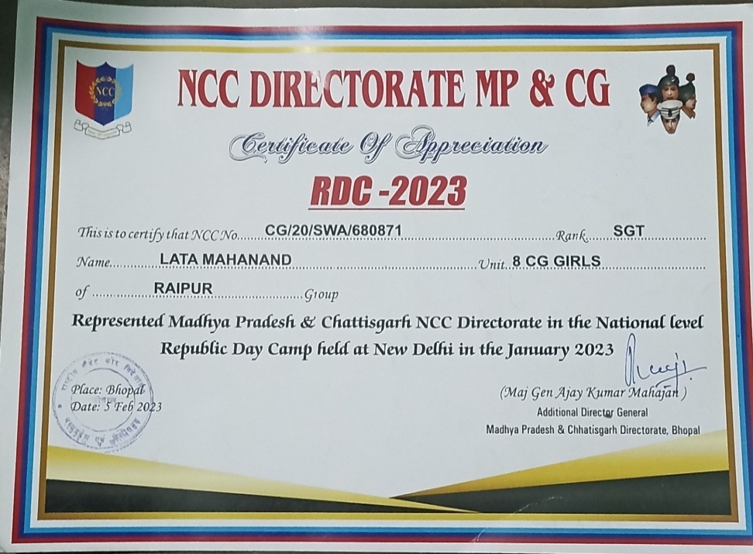
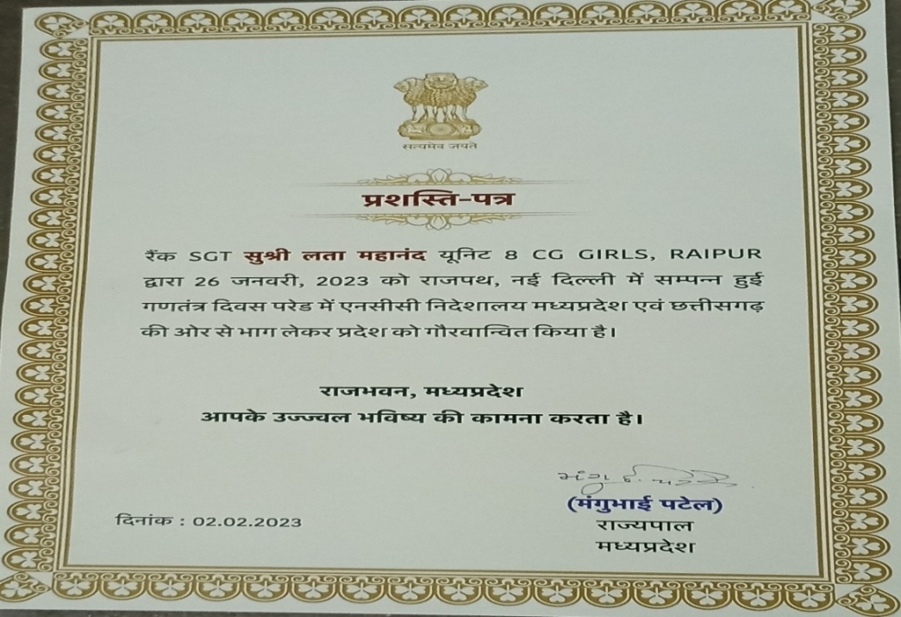
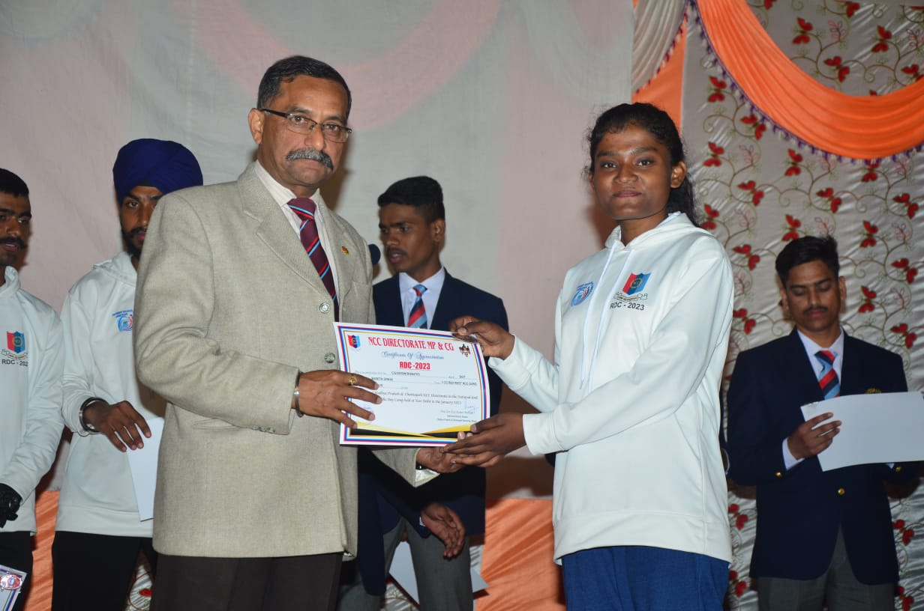
APPRECIATION BY THE CM SHRI SHIVRAJ SINGH CHAUHAN, GOVERNOR SHRI MANGU BHAI PATEL MADHYA PRADESH AND MAJ GENERAL AJAY KUMAR MAHAJAN ADG MP & CG DTE TO SGT LATA MAHANAND

Slide 24
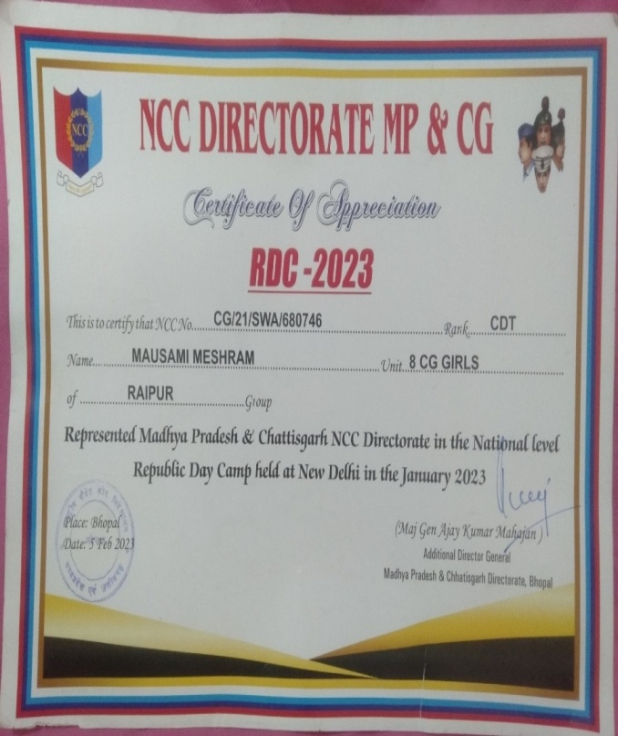
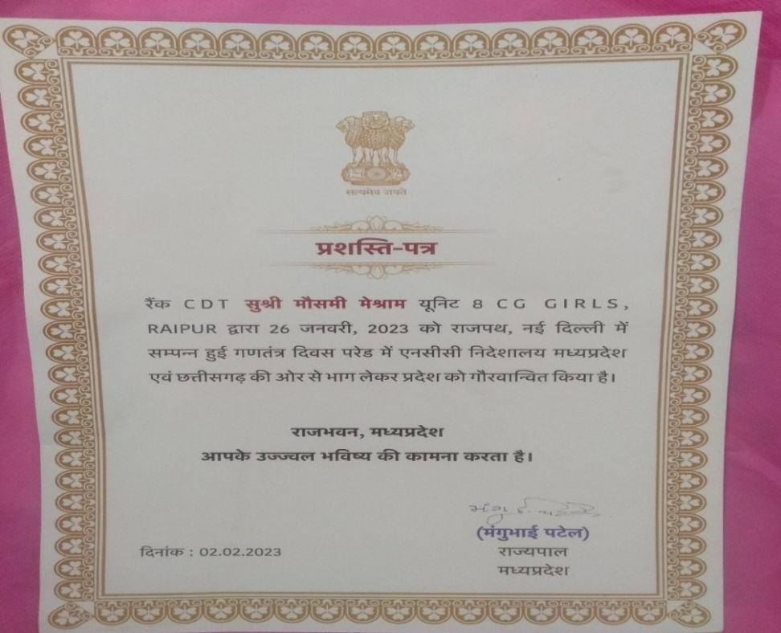
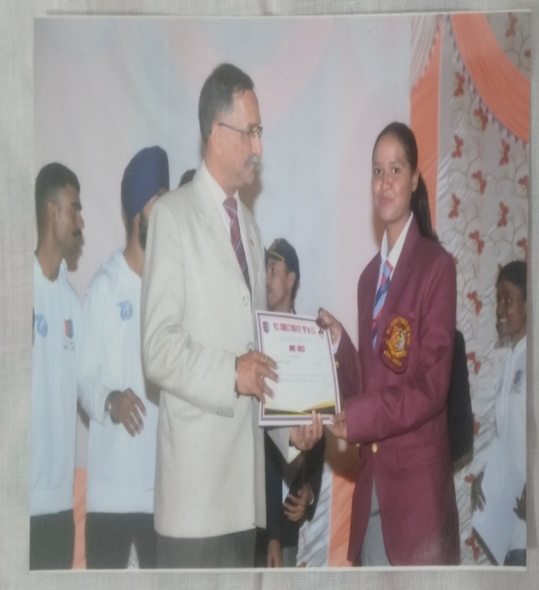
APPRECIATION BY THE CM SHRI SHIVRAJ SINGH CHAUHAN, GOVERNOR SHRI MANGU BHAI PATEL MADHYA PRADESH AND MAJ GENERAL AJAY KUMAR MAHAJAN ADG MP & CG DTE TO LCPL MAUSAMI MESHRAM

Slide 25
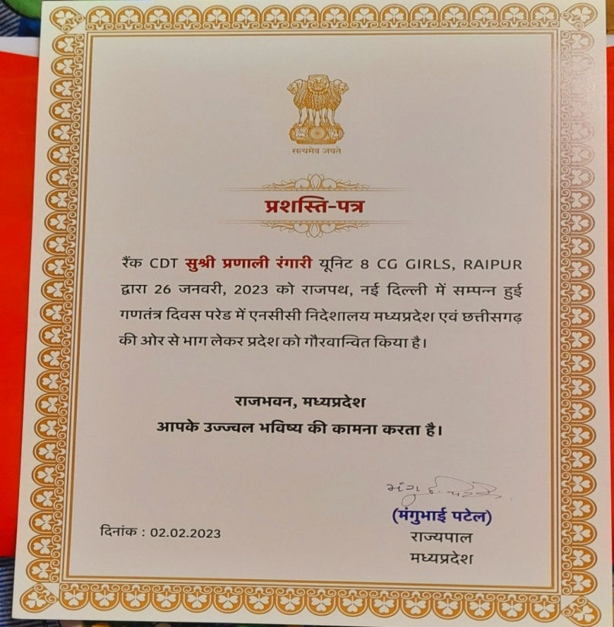
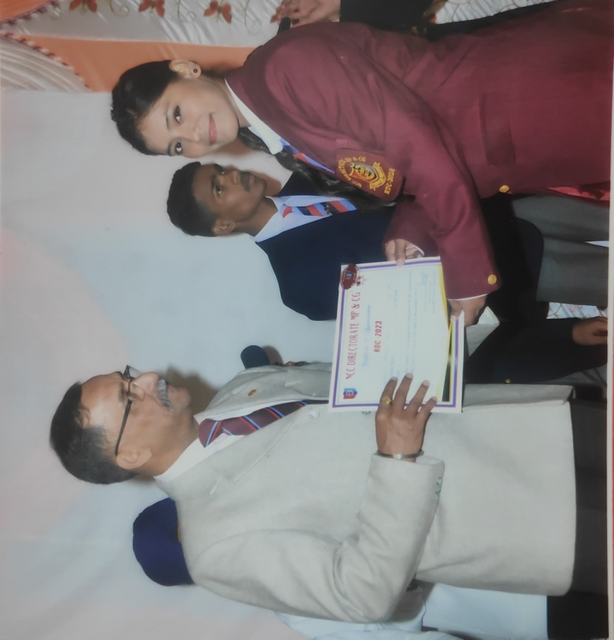
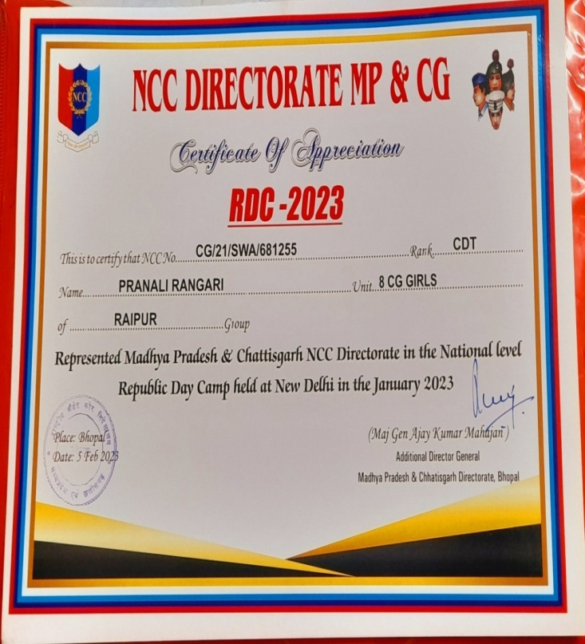
APPRECIATION BY THE CM SHRI SHIVRAJ SINGH CHAUHAN, GOVERNOR MANGU BHAI PATEL MADHYA PRADESH AND MAJ GENERAL AJAY KUMAR MAHAJAN ADG MP & CG DTE TO CDT PRANALI RANGARI

Slide 26


I RECEIVED A CERTIFICATE AND CASH AWARD WORTH RS. 50,000/- AS CHIEF MINISTER OF CHHATTISGARH AWARD FOR THE YEAR 2022-23

Slide 27

SGT LATA MAHANAND RECEIVED CASH AWARD WORTH RS 25,000/- AS CHIEF MINISTER OF CHHATTISGARH AWARD FOR THE YEAR 2022-23

Slide 28

CDT PRANALI RANGARI RECEIVED CASH AWARD WORTH RS 10,000/- AS EDUCATION MINISTER OF CHHATTISGARH AWARD FOR THE YEAR 2022-23

Slide 29

CDT MAUSAMI MESHRAM RECEIVED CASH AWARD WORTH RS. 6000/- AS NCC DAY AWARD FOR THE YEAR -2022-23

Slide 30




ONLINE ESSAY COMPITITION ORGANIZED BY “MERI LIFE CAMPAIGN” ON THE TOPIC “PLASTIC FREE INDIA”UNDER SSCD ACTIVITIEY ON 29/05/2023
23 CADETS PARTICIPATED

Slide 31




ON THE TOPIC“BAD EFFECT OF PLASTICS, CLEANING OF WATER BODIES, ESSAY WRITING, POSTER MAKING ACTIVITY” WERE PERFORMED UNDER PUNIT SAGAR ABHIYAN IN BETWEEN 30/05/2023 TO 05/06/2023
29 CADETS WERE PARTICIPATED

Slide 32




ARTCLE WRITING AND PAINTING COMPITITION WAS CONDUCTED FOR THE PUBLICATION IN E-JOURNAL ON 17 TH JUNE 2023
09 CADETS WERE PARTICIPATED

Slide 33






GENERATED DIGITAL POST CARD ON THE OCCASION OF INTERNATIONAL YOGA DAY ON 19/06/2023
39 CADETS WERE GENERATED

Slide 34






0NLINE PLEDGE TAKEN ON THE OCCASION OF “INTERNATIONAL YOGA DAY” ON 19/06/23
33 CADETS WERE TOOK PLEDGE

Slide 35



CELEBRATED “INTERNATIONAL YOGA DAY” NEAR INDIRA GANDHI AGRICULTURE UNIVERSITY, JORA GROUND ON 21/06/2023
18 CADETS WERE PARTICIPATED

Slide 36






TOOK PLEDGE AND GENERATED CERTIFICATE ON “SAY YES TO LIFE, NO TO DRUGS” ON 26/06/2023
37 CADETS WERE GENERATED CERTIFICATE

Slide 37




ON THE OCCASSION OF “INTERNATIONAL DRUG ABUSE DAY” OUR CADETS WERE PERFORMED CAMPAIGNING ON THE TOPIC “DRUG FREE INDIA” NEAR BY MOUDHAPARA SLUM AREA ON 27/06/2023
28 CADETS WERE PARTICIPATED

Slide 38
VARIOUS CAMP ATTENDED BY THE CADETS
Mavlankar selection camp at Jabalpur from 13/06/2022 to 22/06/2023(1 cadet attended)
TDC EBSB at Delhi from 01/08/2022 t0 15/08/2022 (1 cadet attended)
TSC- I at Bilaspur from 01/08/2022 to 08/08/2022 (5 cadets attended )
TSC-II at Bilaspur from 19/08/2022 to 26/08/2022 (3 cadets attended)
TSC-IGC- I at Sagour from 28/08/2022 to o4/09/2022 (2 cadet attended )
CATC – IX at Lakholi from 29/08/2022 to o5/09/2022 (32 cadets attended)
IGC- Cultural at Indore from 09/10/2022 to 16/10/2022 (3 cadets attended)
Group RDC - from 10/10/2022 to 17/10/2022 ( 5 cadets attended)

Slide 39
CATC -24 DTE RDC-II at Lakholi from 23/11/2022 to 30/11/2022 (11 cadets attended )
CATC -25 DET RDC –III at Lakholi from 15/12/2022 to 22/12/2022 (3 cadet attended)
CATC – 26 PRE RDC at Lakholi from 23/12/2022 to 29/12/2022 (3 cadet attended)
RDC at Delhi from 01/01/2023 to 29/ 01/2023 (3 cadet attended)
DE KITTING CAMP at Bhopal from 31/01/2023 to 07/02/2023 (3 cadet attended)

Slide 40
JAI HIND

